Slide 1
Logical Equivalence
“Sameness of Statements”

Slide 2
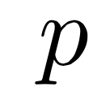
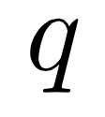
When are two statements the same?
If two statements are equivalent we write:
We say “is equivalent to”

Slide 3
How can we tell if two statements are the same?
If they always have the same truth value...
(i.e. the same truth table)

Slide 4
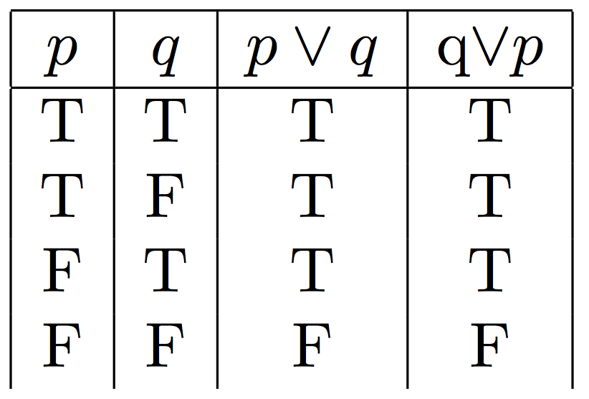
Work out the table!
EQUIVALENT!
THE SAME!
THE SAME!
THE SAME!
THE SAME!

Slide 5
Let’s see another one!

Slide 6
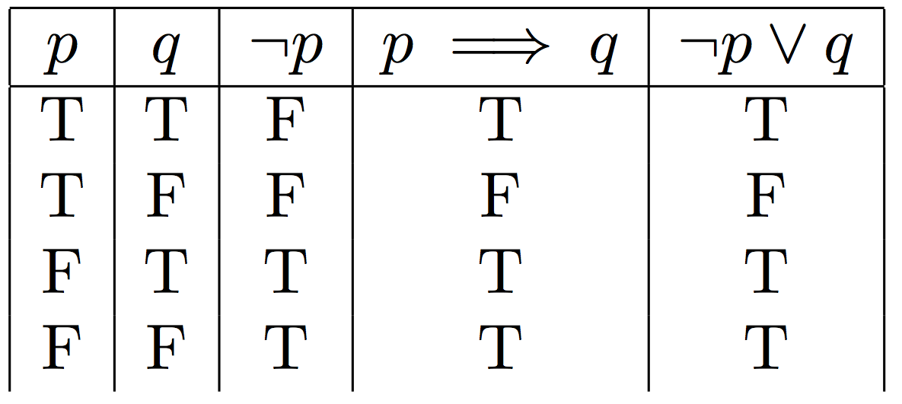
Work dat table out...

Slide 7
Work dat table out...

Slide 8
Work dat table out...

Slide 9
Work dat table out...
EQUIVALENT!

Slide 10
Group Work!

